Slide 1

TCS 2112
01. Business Economics
V.P.V. Audarika
Department of Multidisciplinary Studies
Faculty of Technology
University of Ruhuna

Slide 2

Learning Outcomes
Define Economics and Business Economics
Understand the Need for Economics
Explain Basic Economic Problems
Understand the Basic Problems of an Economy

Slide 3
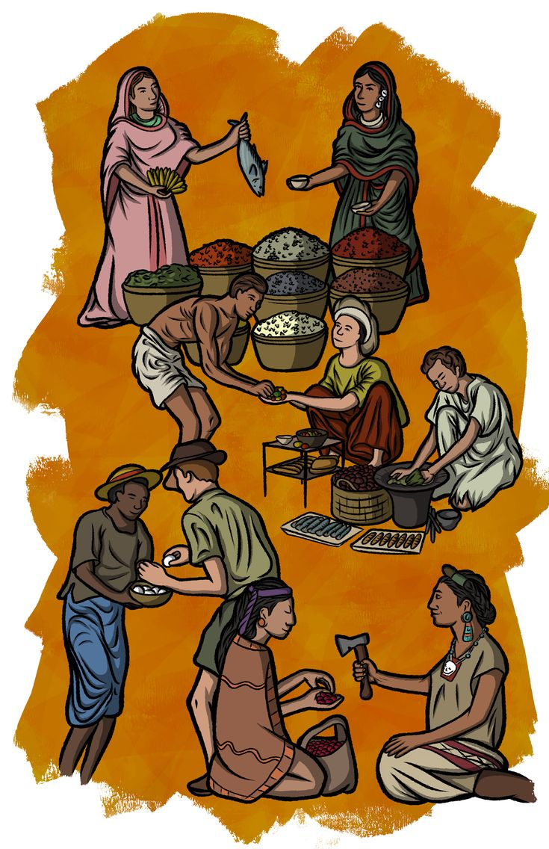

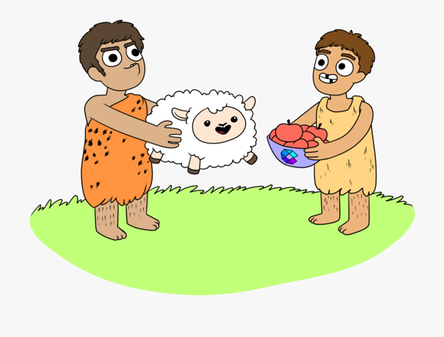
Before Invent Money

Slide 4
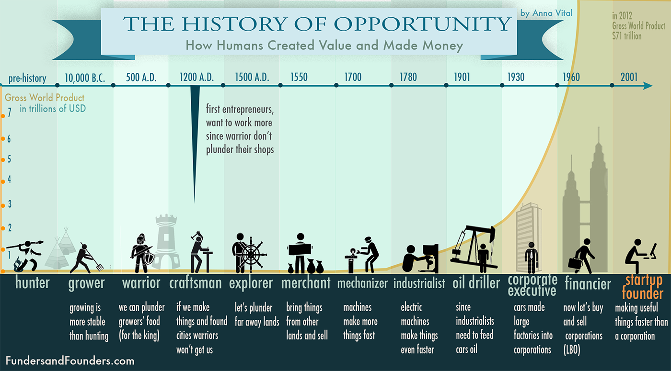
History of Economics

Slide 5
What is economics?
The word ‘Economics’ originates from the Greek word ‘Oikonomikos’ which can be divided into two parts:
‘Oikos’, which means ‘House’, and
‘Nomos’, which means ‘Management’.
Economics is known as the queen of social sciences.

Slide 6
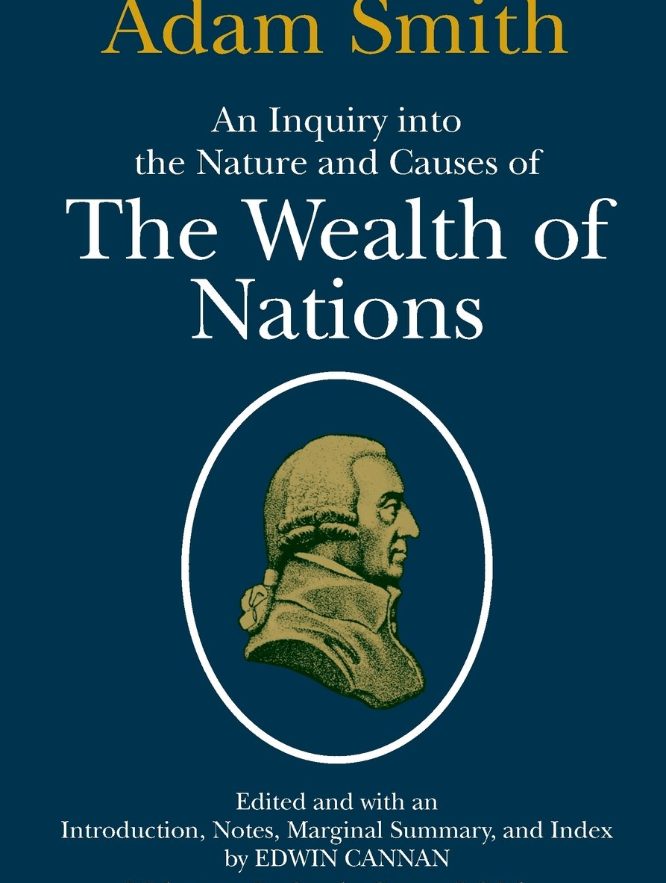
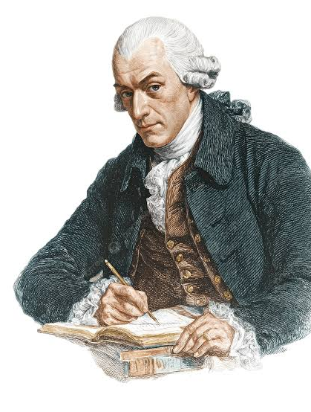
Definitions for Economics
Adam Smith
Father of Economics
The study of nature and uses of national wealth
Economics is the “science of the wealth”

Slide 7
Definitions for Economics (Cont.)
“Economics is a study of man’s actions in the ordinary business of life ; it enquires how he gets his income and how he uses it .”- Dr. Alfred marshall
“the science which studies human behavior as a relationship between ends and scarce means which have alternative uses”- Prof Lionel Robbins

Slide 8
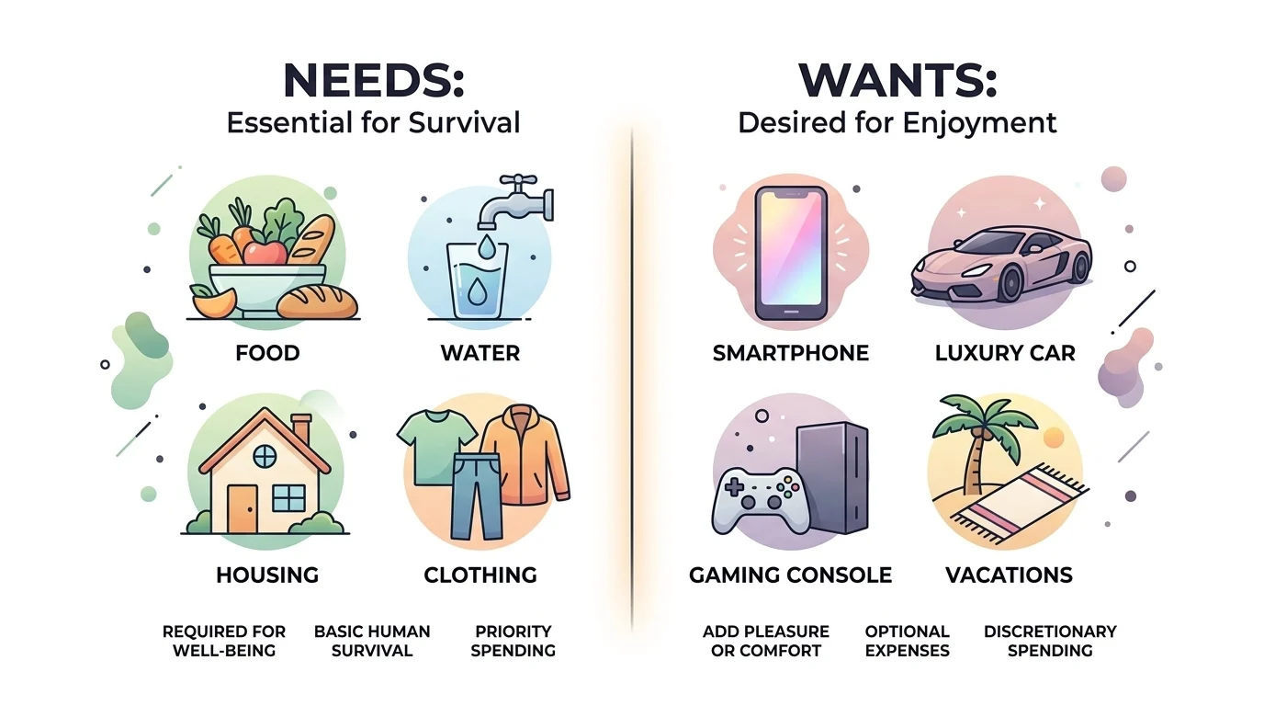
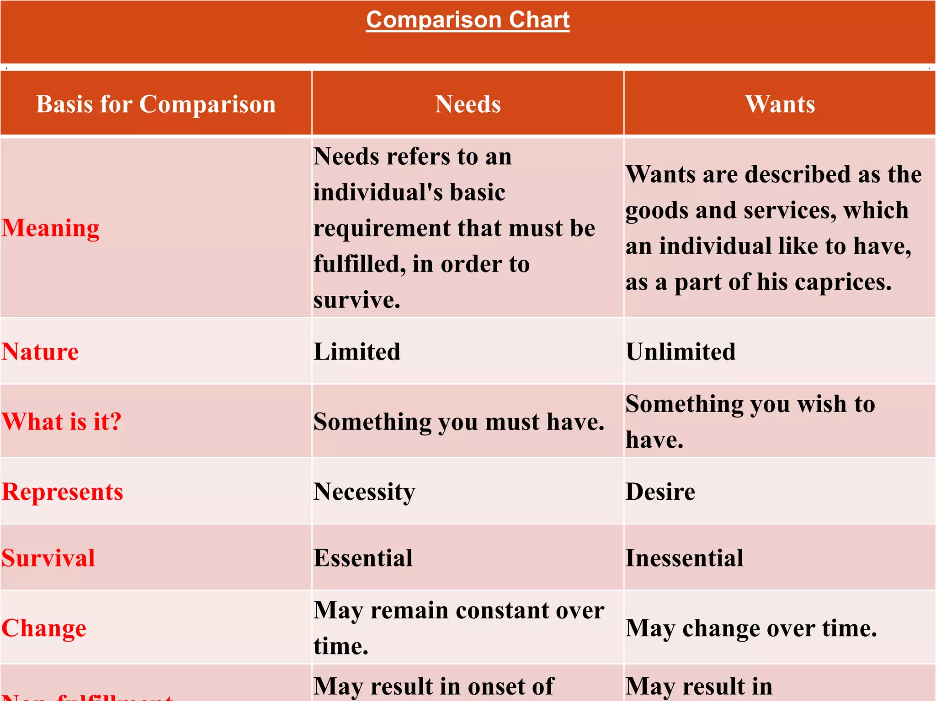
Needs and Wants

Slide 9
Foundation Concept of Economics
Scarcity is the foundation concept of economics
What is Scarcity?
  Resources are very limited compared to the unlimited human needs and wants.
  For an individual, resources include time, money, and skill.
  For a business resources may enable production of goods and services.
  For a country, limited resources include natural resources, capital, labour force, technology, etc.

Slide 10
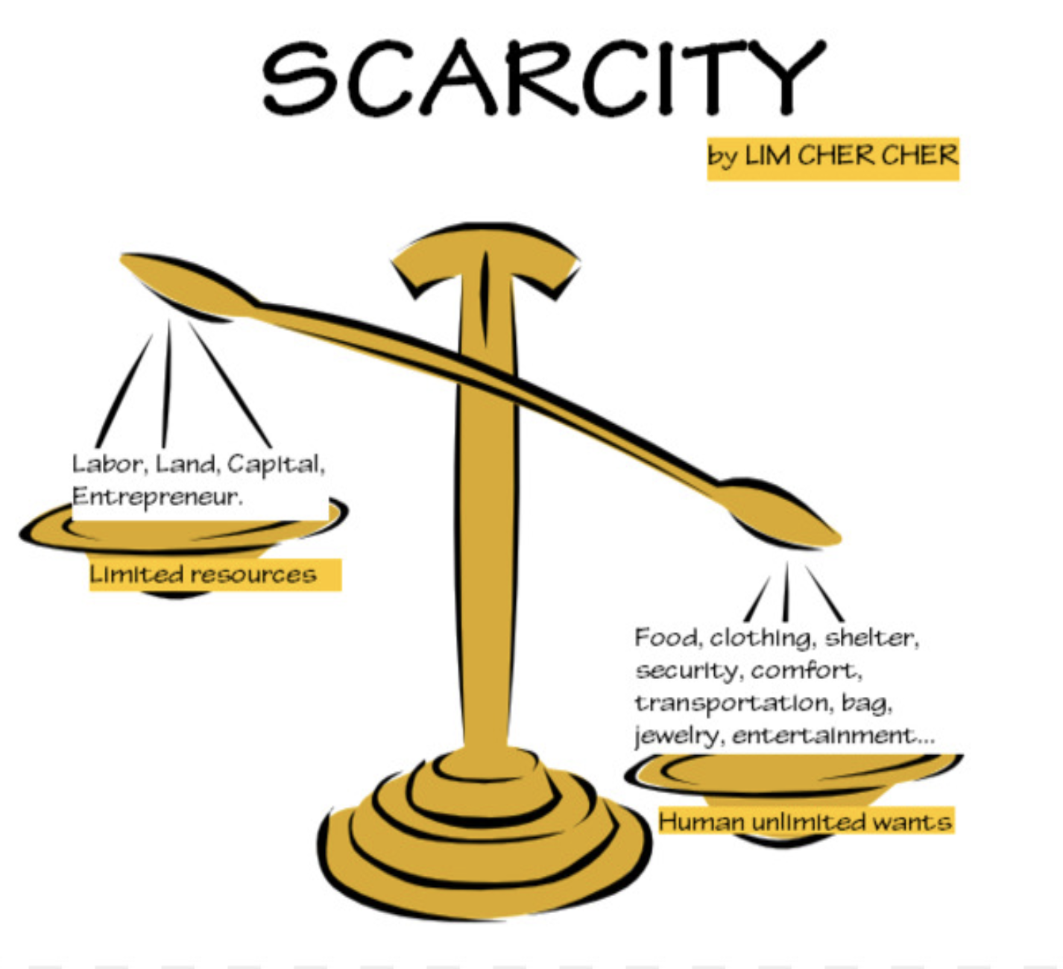
Scarcity
  Points that emphasize about scarcity;
  Scarcity is a common concept for every society.
  Scarcity is a relative concept
  Not reflect inefficiencies
  Does not mean the poverty

Slide 11
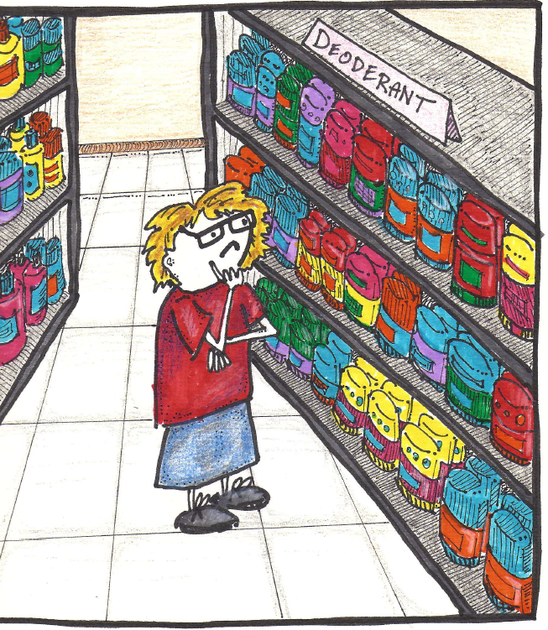
Choice
Choice is the process of deciding which needs of people in society will be met using the scare resources available in an economy.
The question of choice arises for two reasons;
  Lack of resources
  The existence of alternative uses for resources

Slide 12
Tradeoff
You can’t have it all (SCARCITY – remember?), so you have to choose how to spend your money, time, and energy. These decisions involve picking one thing over all the other possibilities – a TRADE-OFF!

Slide 13
Opportunity Cost
Opportunity cost refers to the value of the next best option that must be sacrificed when making a choice among alternative choices regarding an economy activity.
Things to consider when evaluating the concept of opportunity cost;
  Opportunity cost is a concrete concept
  Opportunity cost is a subjective concept
  Not limited to a person making the decision

Slide 14
Opportunity Cost (Cont.)
Situations where the opportunity cost can be zero;
  opportunity cost is zero for free goods
  opportunity cost is zero when there are no alternatives
  In the situation of general unemployment

Slide 15
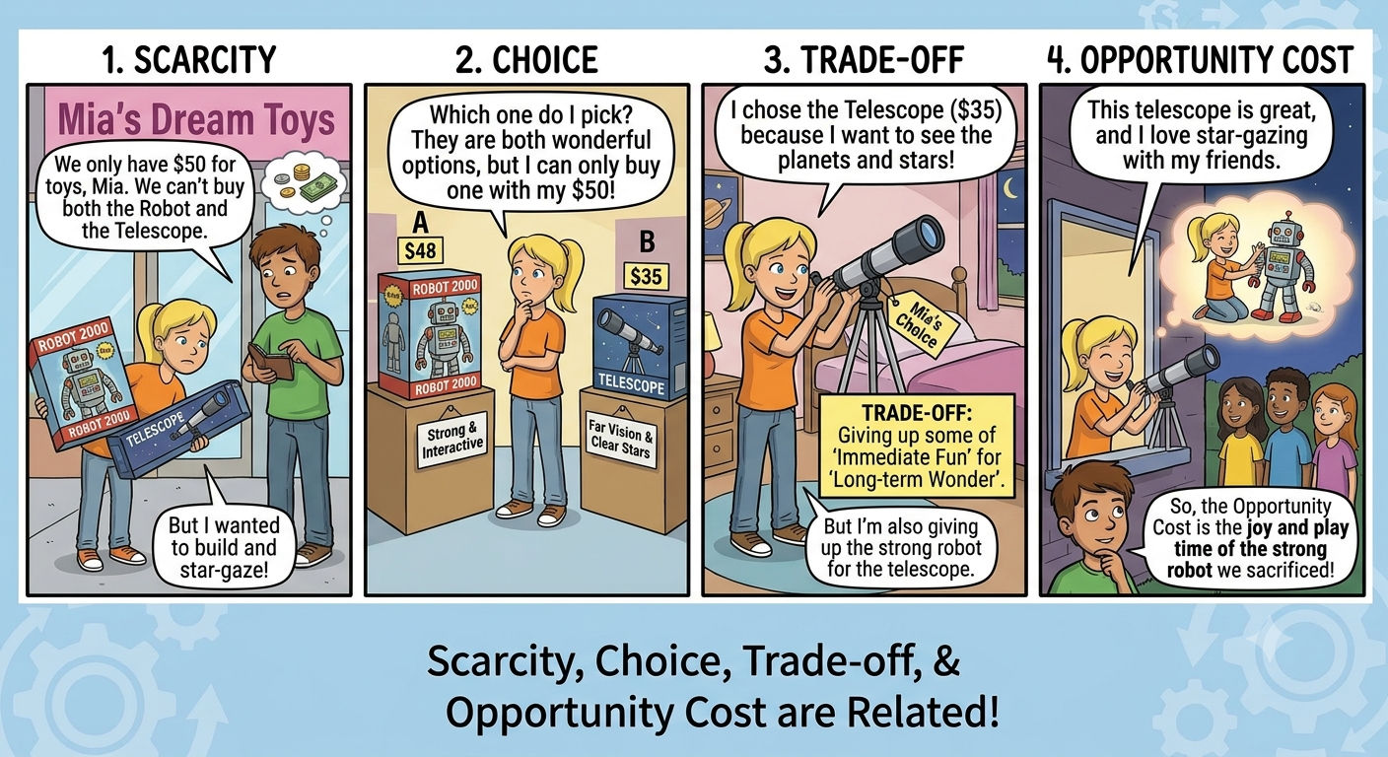

Slide 16
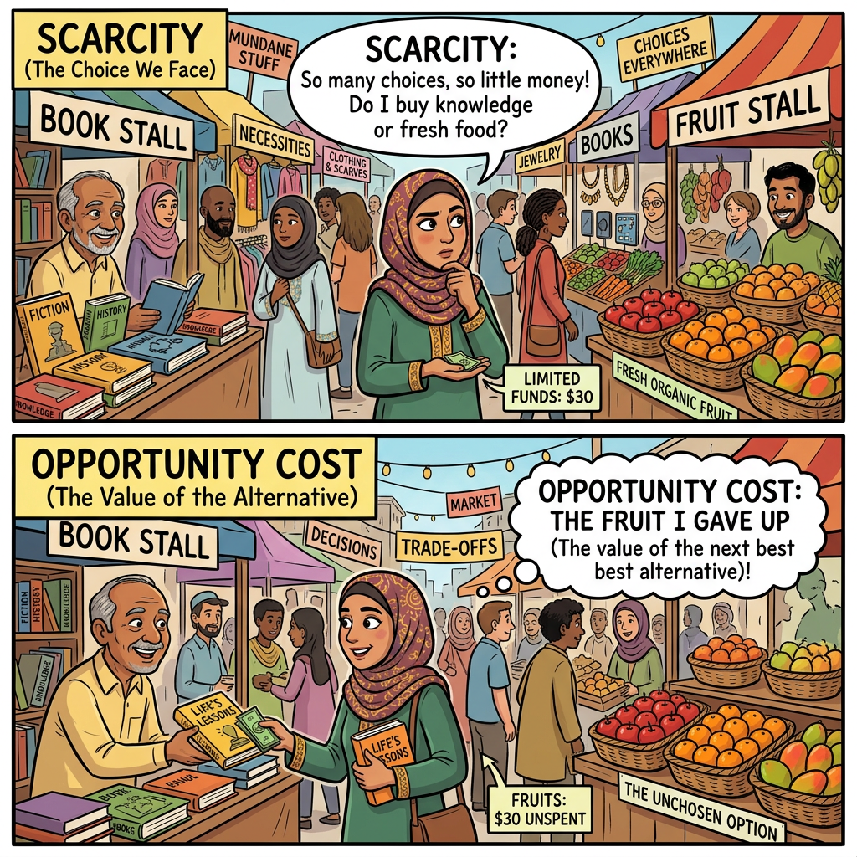
Basic Economics concepts in Nutshell
Scarcity
Choice
Opportunity Cost

Slide 17
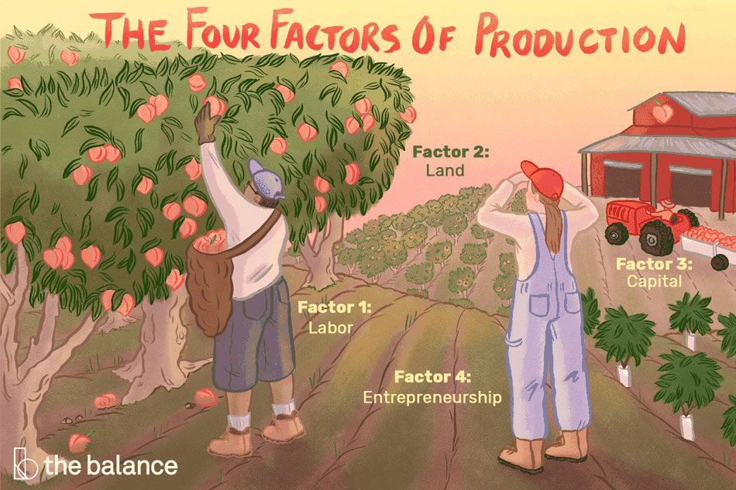
Factors of Production
Production factors refer to the factors that are used for produce goods and service to produce income.
  Land
  Labor
  Capital
  Entrepreneurship

Slide 18
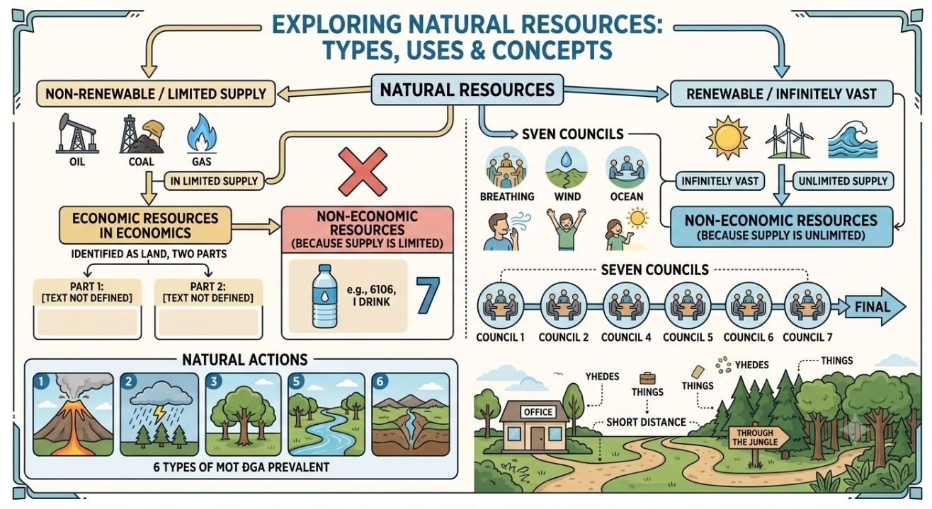
Land
Land includes the natural resources utilize to create goods or service.

Slide 19

Labour
Labour is the work done by the people in a work force.
Labour is heterogeneous
Perishable in nature
Strongly associate with human effort
Includes skilled and unskilled workers
Training improves productivity and quality

Slide 20
Capital
Capital refers to capital goods or man-made resources.
Capital goods are distinguished from consumer goods.
  Fixed capital: ponds, cages, aerators, boats
  Working capital: feed, fuel, medicines, fingerlings
  Technology increases efficiency
Ex: Machinery, Buildings, Raw materials

Slide 21
Entrepreneurship
Entrepreneurship combines, control and manage all the factors of production to produce products or service.
The man who undertake this process called as entrepreneur.
Organizing and risk management are the two main functions of the entrepreneur.

Slide 22
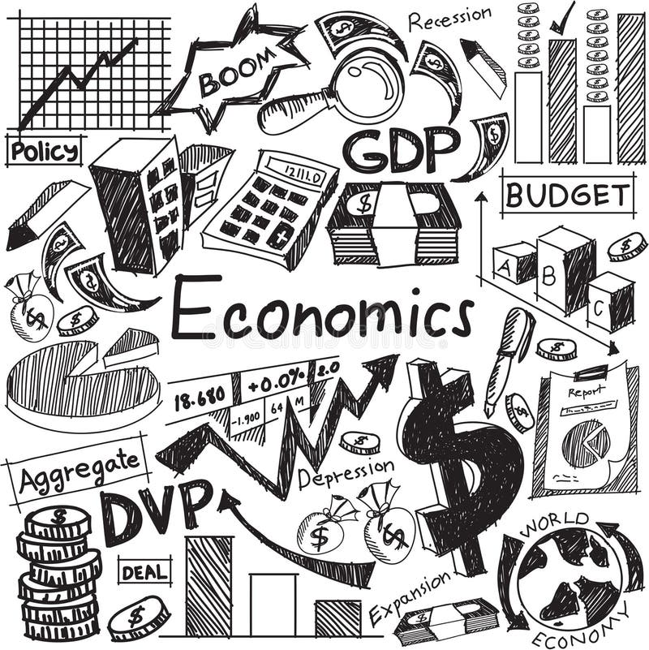
What is Economics
Economics is the study of how people allocate their limited resources to produce goods and services to satisfy their endless wants and to maximize their gains.

Slide 23

Business Economics
Business economics is the application of economic theory and methodology to solving business problems.

Slide 24
Philosophy of Economics
Positive Economics
Answers the questions, what is? What happened? What will happen?.
A statement of fact is used to show the relationship between several variables or to explain phenomenon.
The accuracy of such statement can be tested by empirical evidence (information gathered from real world). When the positive statement does not match the empirical evidence, then that statement is rejected.
Ex: There is an inverse relationship between money supply and price level

Slide 25
Philosophy of Economics (Cont.)
Normative Economics
A factual statement can be true or false. Focuses on what ought to be.
These statements are subjective.
Ex: Income should be distributed equally
Minimum wages should be increased

Slide 26
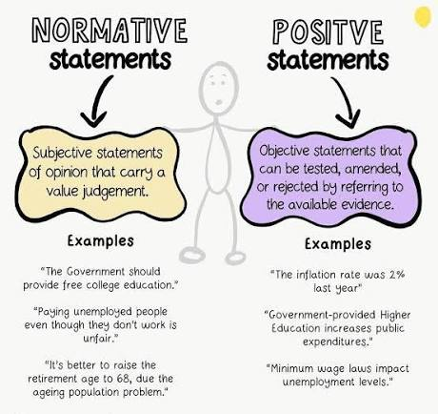
Philosophy of Economics

Slide 27
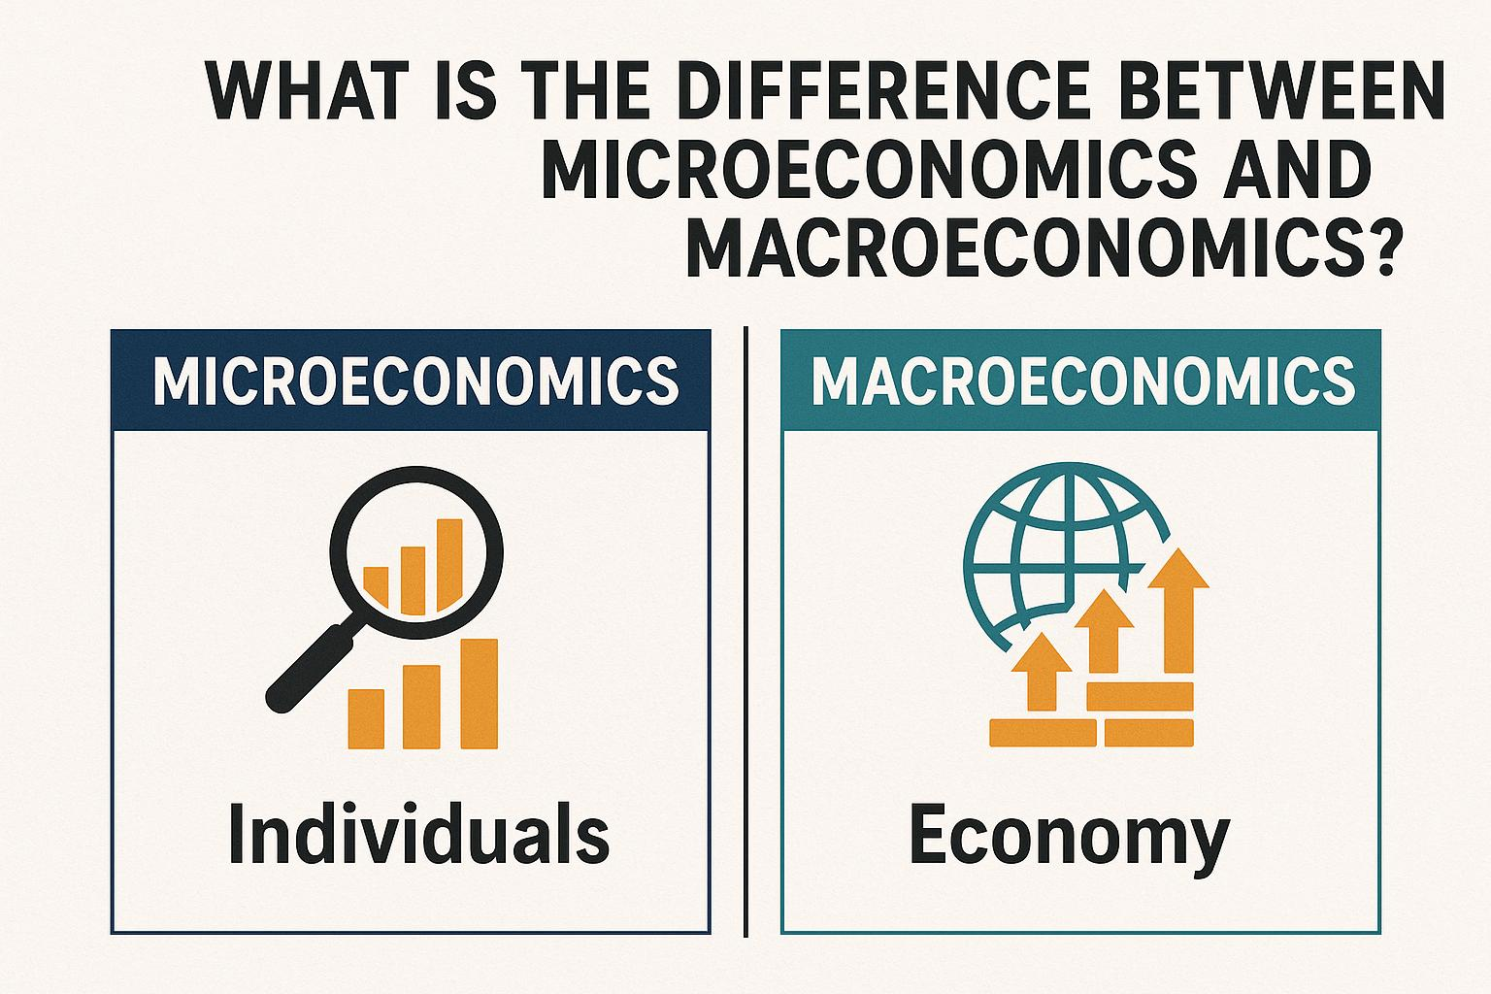
Economics
Economics
Microeconomics
Macroeconomics

Slide 28
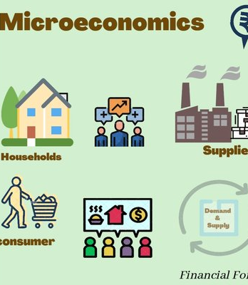
Microeconomics
Microeconomics focuses on analyzing the behavior of various units in an economic system including consumers, workers, production institutions and government.
Ex: A customer deciding to buy a smartphone based on its price, features, and budget.
A farmer deciding how much wheat to produce based on market prices

Slide 29


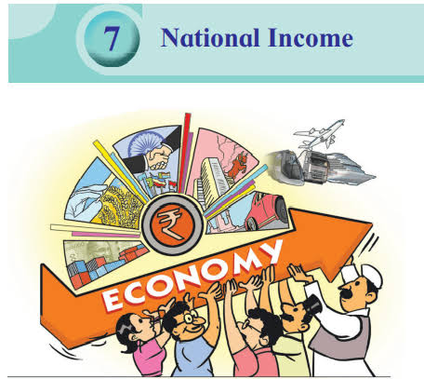
Macroeconomics
Macroeconomics is analysis of the structure, performance and behavior of an economic system as a whole.
  EX: Inflation
  Unemployment
  Balance payment
  Exchange rate

Slide 30
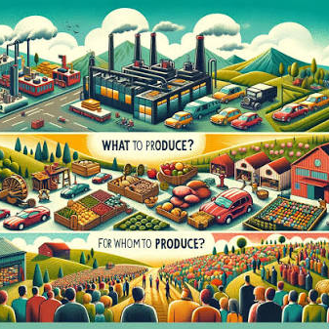
Fundamental Economic Questions
There are three basic economic problems that every developed and developing society faces in common. These problem arise from the central economic problem of scarcity. They are;
  What to produce?
  How to produce?
  For whom are the goods produced?

Slide 31
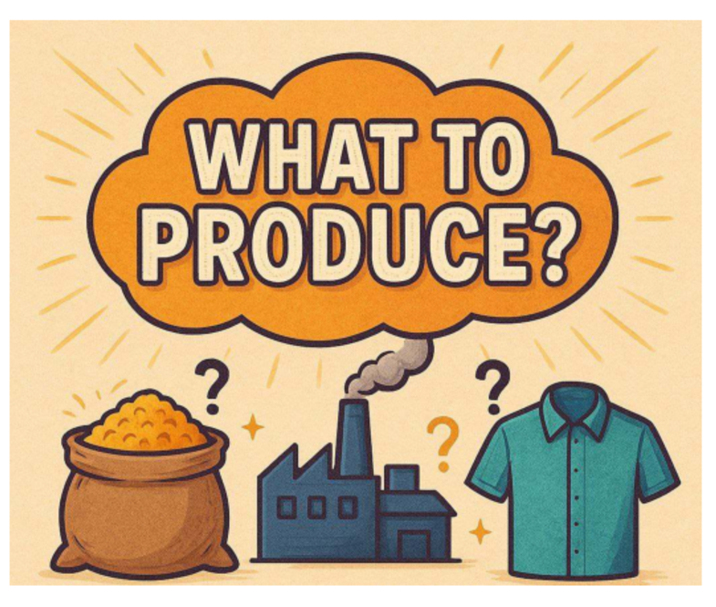
What Goods Should Be Produced?
An economy wants many things, but all these cannot be produced with the available resources.
Therefore, an economy has to choose what goods should be produced and what goods should not be.

Slide 32

How to produce?
Which technique should be used for the production of given commodities?
This problem arises because there are various techniques available for the production of a commodity
Such as, for the production of wheat, we may use either more of labor and less capital or less of labor or more of capital.

Slide 33

For whom to produce?
The main objective of producing a commodity is its consumption in the economy.
An Economy has to decide for whom goods should be produced.
This is the problem of the distribution of produced goods and services. Therefore, what goods should be consumed and by whom depends on the distribution of the National Product.

Slide 34
Types of Economics
Types of Economics
Market
Command
Mixed

Slide 35



Market Economy
In a pure market economy, there is no government involvement in economic decisions.
  In a free market economy, economic decisions are primarily made by private individuals and firms.
  Economic questions answered by producers and consumers Wide variety of choices and product
  Ex: Singapore, Switzerland, Taiwan

Slide 36
How the free-market answers basic economic questions
1. What? consumers decide what should be produced in a market economy through the purchases they make.
2. How? production is left entirely up to businesses. businesses must be competitive in such an economy and produce quality products at lower prices than their competitors.
3. For whom? in a market economy, the people who have more money are able to buy more goods and services.

Slide 37
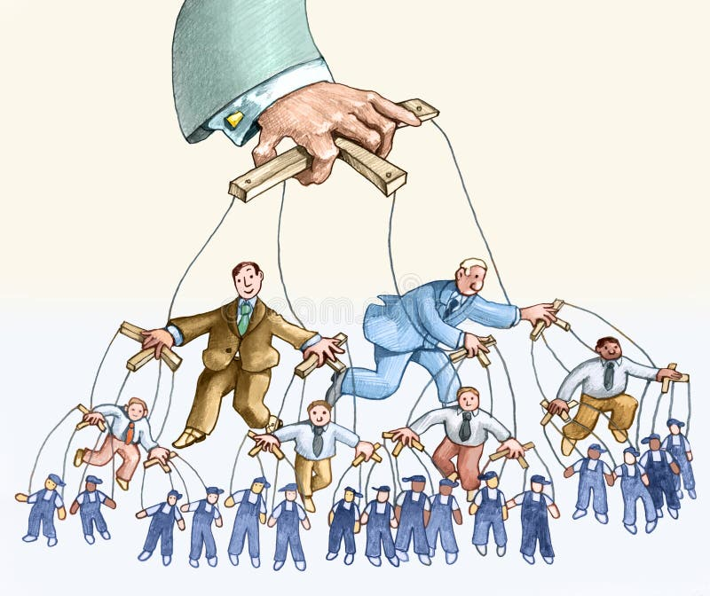
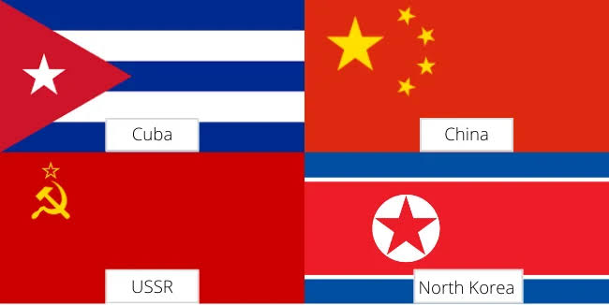
Command Economy
A command economy is an economic system where the central government plans and controls all major aspects of production and distribution of goods and services.
  Economic questions answered by the government
  Very little choice
  No private ownership
  Communism
  Ex: Old Soviet union, Cuba, Communist china,
  Noeth Korea

Slide 38
How the command economy answers basic economic questions
1.What? A central planning committee decides what products are needed.
2. How? Since the Government owns all means of production in a command economy, it decides how goods and services will be produced.
3. For Whom? The Government decides who will get what is produced in a command economy.

Slide 39
Mixed Economy
In the Mixed economies, the Government and the Market work together in decision making .
  Government involvement and ownership in control of property, decision-making, and companies.
  Government control of businesses through regulations
  Social “safety net” for people
  Socialism
  EX: Common in Europe, Latin America, Asia, and Africa

Slide 40
How the command economy answers basic economic questions
  What? Determined partly by consumer preferences and partly by government.
  How? Determined partly by producers seeking profit and partly by government.
  For Whom? Determined partly by purchasing power and partly by government preference.

Slide 41


What do you think about type of Sri Lankan Economy?

Slide 42
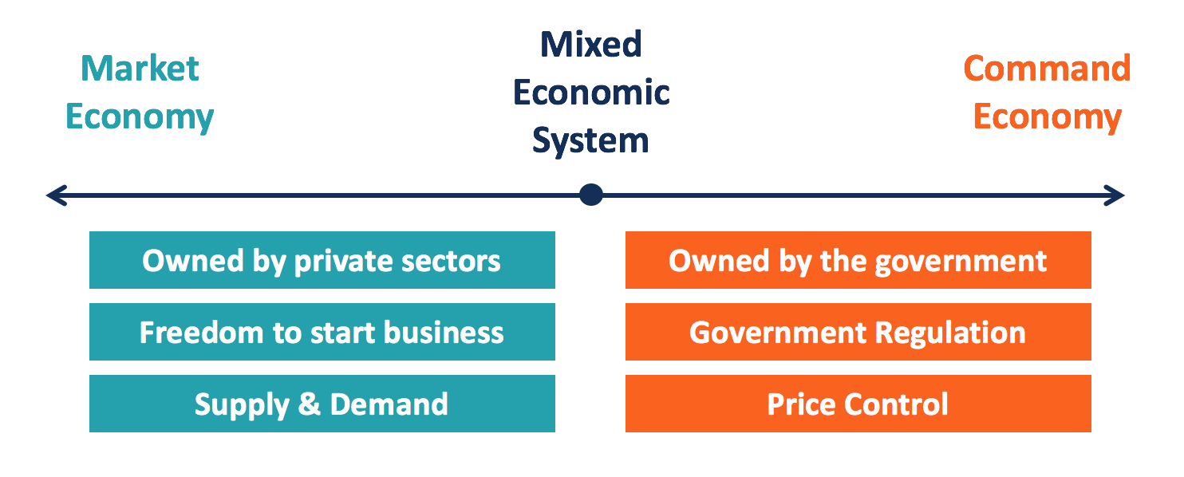
Market Types in Brief…

Slide 43

Why do we learn economics
To understand the world around us
To make better personal decisions
To understand how governments and businesses work
To Understand Markets and Predict Changes
To improve society

Slide 44


